Slide 1


basketball student-Athlete
Seniors
2020-21

Slide 2
Augustana men’s
basketball

Slide 3
Jack jelen
Hometown: Bay Village, Ohio
Academic Major: Environmental Studies
Post-Collegiate Plans: Still trying to figure it out.

Slide 4
Augustana women’s
basketball

Slide 5
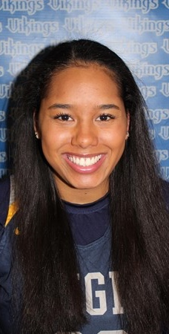
Justice edell
Hometown: Rock Island, Illinois
Academic Major: Biology with a Pre-Physicians Assistant influence
Post-Collegiate Plans: I will work as a Certified Nursing Assistant for the next year. I plan to attend graduate school in the fall of 2022.

Slide 6
Carroll men’s
Basketball

Slide 7
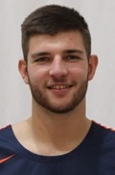
Tarren hall
Hometown: Mauston, Wisconsin
Academic Major: Finance
Post-Collegiate Plans: I currently plan on becoming a financial advisor. I am planning on working at Thrivent Financial directly out of school.

Slide 8
carroll women’s
basketball

Slide 9
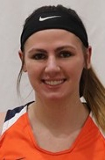
Ashley fontaine
Hometown: Oshkosh, Wisconsin
Academic Major: Business Administration
  minors: Spanish and Management & Leadership
Post-Collegiate Plans: Currently deciding between different business job opportunities in the Wisconsin area. Hoping to one day find a job working in international business.

Slide 10

Carthage men’s
basketball

Slide 11
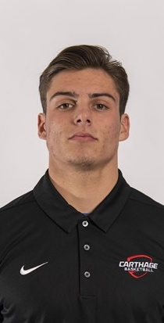
TJ best
Hometown: Arlington Heights, Illinois
Academic Major: Business Management and Marketing
Post-Collegiate Plans: Plans to work in sales for RHM.

Slide 12
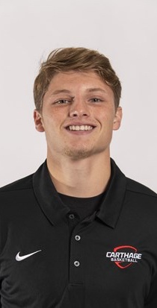
Josh washburn
Hometown: Kenosha, Wisconsin
Academic Major: Business Management

Slide 13
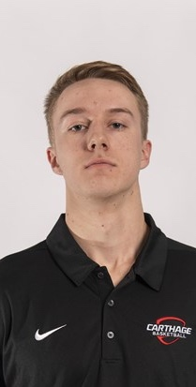
Kyle peirce
Hometown: Ada, Michigan
Academic Major: Marketing and Management
Post-Collegiate Plans: Planning on going into sales after college in the Chicagoland area. Recently accepted a sales job in the Schaumburg area upon graduation.

Slide 14
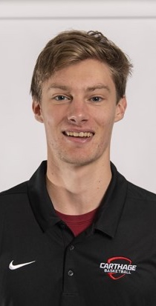
Sean johnson
Hometown: Chicago, Illinois
Academic Major: Mathematics
Post-Collegiate Plans: Still undecided on whether I will attend graduate school next year or begin working. In the future, I hope to find myself in a career in data analytics, data science, or something similar. Eventually, I hope to use my data analysis skills in the context of sports, ideally for a professional sports league or team.

Slide 15
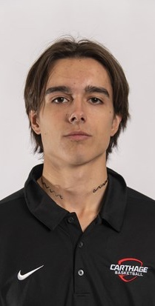
Marko drazic
Hometown: Belgrade, Serbia
Academic Major: Computer Science

Slide 16
Carthage women’s
basketball

Slide 17
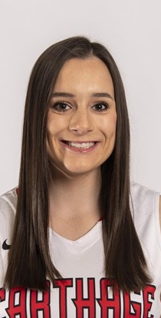
Amanda larson
Hometown: Grayslake, Illinois
Academic Major: Management

Slide 18
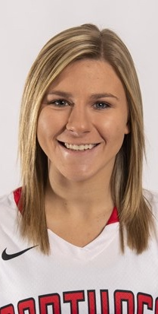
Taylor jozefowicz
Hometown: Crystal Lake, Illinois
Academic Major: Psychology
Post-Collegiate Plans: I’ll be attending Carroll University in the summer to attend their Masters of Occupational Therapy program. I’m very excited to start working on my degree and getting into the field as soon as I possibly can!

Slide 19

Elmhurst men’s
basketball

Slide 20
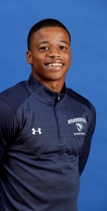
Nick perry
Hometown: Flossmoor, Illinois
Academic Major: Sports Management
Post-Collegiate Plans: I plan to possibly get my masters here at Elmhurst University while also getting my real estate brokers license.

Slide 21
Elmhurst women’s
basketball

Slide 22
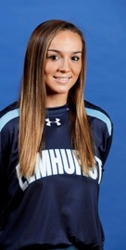
Marissa urso
Hometown: St. Charles, Illinois
Academic Major: Business Management with an emphasis in entrepreneurship and operations
Post-Collegiate Plans: After I graduate, I plan to attend graduate school and achieve my MBA. My career plan is to get into the medical device sales industry.

Slide 23
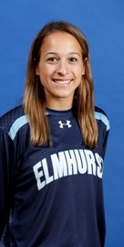
Mia reese
Hometown: Hebron, Indiana
Academic Major: Sport Management and Business Administration
  minor: Coaching
Post-Collegiate Plans: After graduation, I plan to obtain a graduate assistant position in an athletic department either in Student-Athlete Development, Academic Services, Coaching, or Game Operations, and earn my masters in Sport Management or Business Administration. In the future, I hope to hold a position in a collegiate athletic department where I am able to empower and help female student-athletes achieve their own goals.

Slide 24
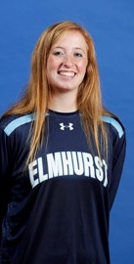
Kourtney schuetz
Hometown: Arlington Heights, Illinois
Academic Major: Elementary Education
  minor: math and teaching students with exceptionalities
Post-Collegiate Plans: I am hoping to teach in an elementary school and possibly coach as well.

Slide 25
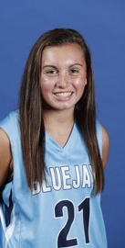
Emma nelson
Hometown: Forreston, Illinois
Academic Major: Communication Sciences and Disorders and Psychology
Post-Collegiate Plans: I plan to stay at Elmhurst University for the next 2 years to complete my graduate degree in Speech-Language Pathology. Afterwards, I hope to work in an outpatient clinic or hospital with neurologically deficit individuals.

Slide 26
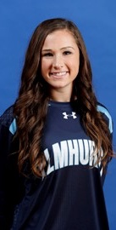
Kelly weyhrich
Hometown: Arlington Heights, Illinois
Academic Major: Elementary Education
  Minor: Special Education
Post-Collegiate Plans: When I graduate from Elmhurst, I plan on becoming an Elementary School Teacher. I have not currently decided on where I plan to teach, but would love to work in the Illinois or Wisconsin area.

Slide 27
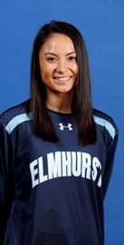
Elena cabrera
Hometown: Batavia, Illinois
Academic Major: Accounting and Finance
Post Collegiate Plans: After college, I have a job lined up at Porte Brown, a public accounting firm. I plan to begin studying for my CPA once I graduate. A few of my goals are to gain good experience, figure out what I enjoy doing in my field, and move my way up in a company as my career progresses.

Slide 28
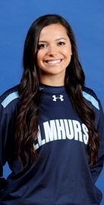
Courtney o’donnell
Hometown: New Lenox, Illinois
Academic Majors: Biochemistry and Psychology
  Minors: Spanish and Religious Studies
Post-Collegiate Plans: After I graduate, I plan to accept a Graduate Assistant Position in the Office of Student Affairs at Elmhurst University and obtain my MBA in Health Care Administration. During that year, I will also be applying to medical schools in the Midwest. From there, my goal is to become an anesthesiologist or dermatologist.

Slide 29

Illinois Wesleyan men’s
basketball

Slide 30
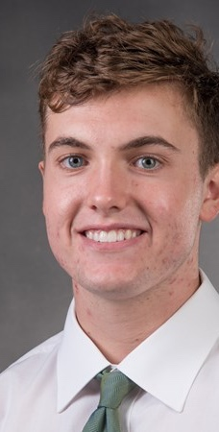
Colin cheaney
Hometown: Batavia, Illinois
Academic Major: Mathematics
Post-Collegiate Plans: Work as a Performance Analyst at Marquette Associates in Chicago, IL.

Slide 31
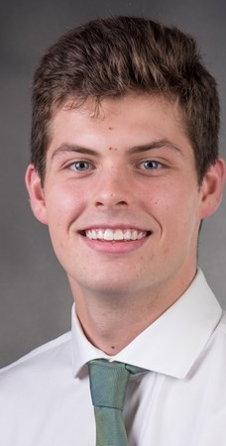
Doug wallen
Hometown: Champaign, Illinois
Academic Major: Business Marketing
Post-Collegiate Plans: My post collegiate plans are to attend the University of Illinois while working toward obtaining my masters degree in the field of Labor and employment relations. This is a 3 semester program and will start in fall of 2021.

Slide 32
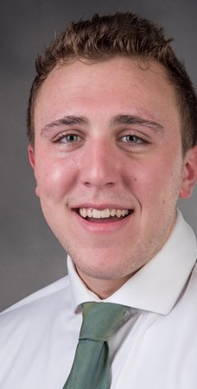
Charlie bair
Hometown: Glen Ellyn, Illinois
Academic Major: Finance
Post-Collegiate Plans: I am hoping to get into sales. I am still deciding between a few different insurance companies.

Slide 33
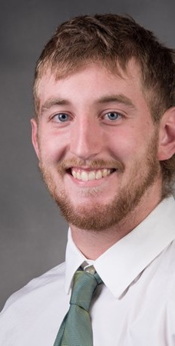
Grant wolfe
Hometown: Effingham, Illinois
Academic Major: Finance

Slide 34
Illinois Wesleyan women’s
basketball

Slide 35
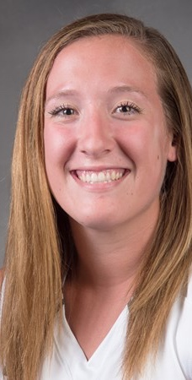
Riley brovelli
Hometown: Oglesby, Illinois
Academic Major: Nursing
Post-Collegiate Plans: I plan on pursuing a career in Obstetrics as a Labor and Delivery nurse. In the future, I want to return to graduate school to further my nursing education and practice.

Slide 36
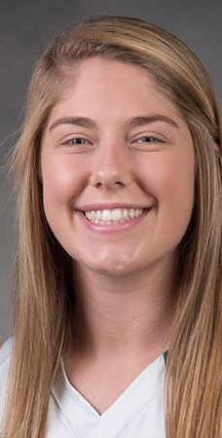
Anna lowis
Hometown: Springfield, Illinois
Academic Major: Nursing
  minor: Health
Post-Collegiate Plans: I plan to work as a registered nurse in an intensive care unit or emergency department with an end goal of becoming a certified registered nurse anesthetist.

Slide 37
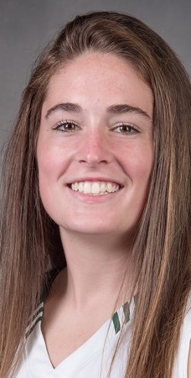
Samantha munroe
Hometown: St. Charles, Illinois
Academic Major: Elementary Education
Post-Collegiate Plans: After college, I plan on landing a middle school teaching job near my hometown. In addition to this, I hope to find my way back to the court with a coaching position as well.

Slide 38
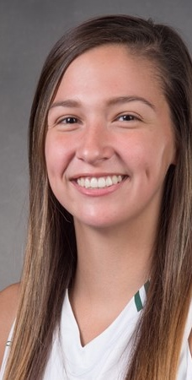
Kendall sosa
Hometown: Bloomington, Illinois
Academic Major: Business Marketing/Graphic Design

Slide 39
Millikin women’s
basketball

Slide 40
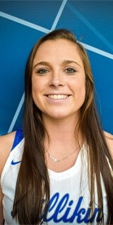
Aubrey magro
Hometown: Rochester, Illinois
Academic Major: Criminal Justice BA, Business Administration MBA
Post-Collegiate Plans: Plans on moving to Louisville to work for Cincinnati Bell Technology Solutions as an account manager.

Slide 41
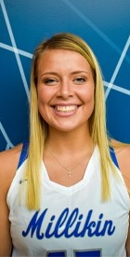
Jordan hildebrand
Hometown: Mendon, Illinois
Academic Major: Nursing
Post-Collegiate Plans: Plans to acquire a nursing position on a pediatric unit after graduation. Following that, plans to further education to obtain nurse practitioner and sub-specialize in individuals with developmental disabilities.

Slide 42

North central men’s
basketball

Slide 43
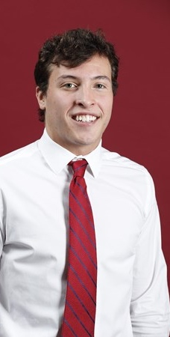
Matt smietanski
Hometown: Homer Glen, Illinois
Academic Major: Accounting

Slide 44
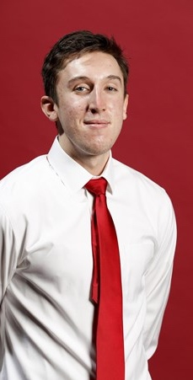
Matthew helwig
Hometown: Aurora, Illinois
Academic Major: Sports Management
Post-Collegiate Plans: After graduating I would like to find a role in a sports organization, preferably baseball. Or, I would also like to explore some coaching opportunities at the college level.

Slide 45
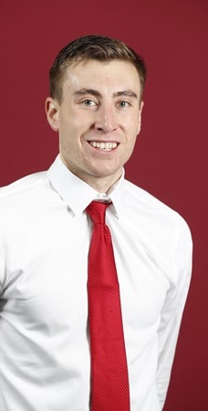
Michael pollack
Hometown: Dekalb, Illinois
Academic Major: Physics & Economics
Post-Collegiate Plans: Commissioned Active-Duty Air Force 2nd Lieutenant. First Duty Station: Tyndall Air Force Base, Florida for Air Battle Manager Training.

Slide 46
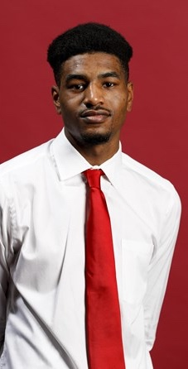
Blaise meredith
Hometown: Naperville, Illinois
Academic Major: Sport Management
Post-Collegiate Plans: Following graduation, I hope to land a career in my field. Sports are a huge part of our society and I hope to be part of the generation that brings live sports back, at full capacity! I also hope to coach youth basketball.

Slide 47
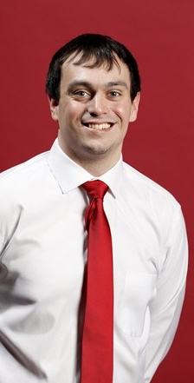
Will clausel
Hometown: Newark, Illinois
Academic Major: Broadcast Communication
Post-Collegiate Plans: Apply to get into graduate school. Try to be a graduate assistant to get into coaching.

Slide 48
Nathan townsen
Hometown: Chicago, Illinois

Slide 49
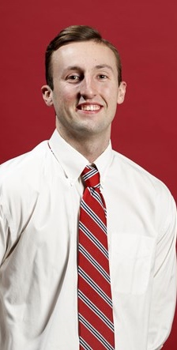
Will hrubes
Hometown: Germantown, Tennessee

Slide 50
North central women’s
basketball

Slide 51
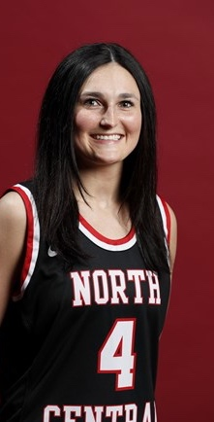
Hayden braun
Hometown: Fishers, Indiana
Academic Major: Sport Management
  Minor: Psychology
Post-Collegiate Plans: I am currently undecided on what I want to do post-graduation. I hope to either find a job in sports marketing or possibly get my masters abroad.

Slide 52
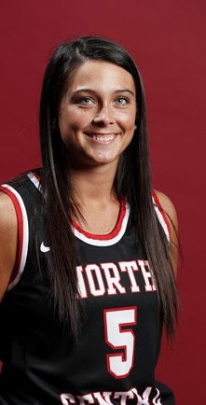
Page desenberg
Hometown: Warsaw, Indiana
Academic Major: Elementary Education
Post-Collegiate Plans: After my senior year, I plan on finding a teaching job close to Naperville or back home. I would prefer to teach third – sixth grade. I am excited for what the future holds!

Slide 53
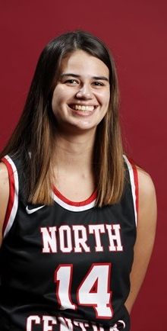
Rebekah foley
Hometown: Waukegan, IL
Academic Major: Accounting
Post-Collegiate Plans: After my senior season I will be staying in the Naperville area, hoping to get a full-time job within the accounting or business-related field.

Slide 54

North park men’s
basketball

Slide 55
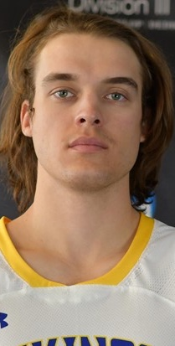
Tobias marek
Hometown: Austin, Texas
Academic Major: Accounting
Post-Collegiate Plans: To begin my professional career in the business world and see where that may take me.

Slide 56
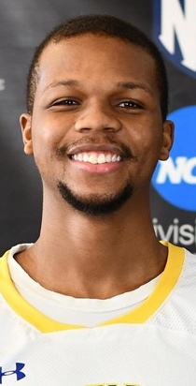
Lawrence pointer
Hometown: Chicago Heights, Illinois
Academic Major: Communication

Slide 57
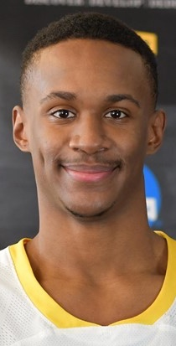
Izaiah sanders
Hometown: Chicago, Illinois
Academic Major: Mechanical Engineering

Slide 58
North park women’s
basketball

Slide 59
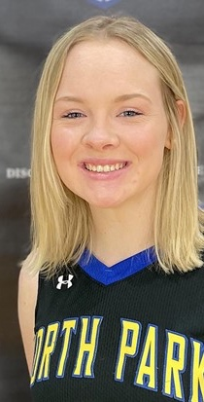
Sinead molloy
Hometown: Chicago, Illinois
Academic Major: Nursing
Post-Collegiate Plans: After graduating I hope to get a job as a labor and delivery nurse or a pediatrics nurse. I plan to stay in Chicago.

Slide 60
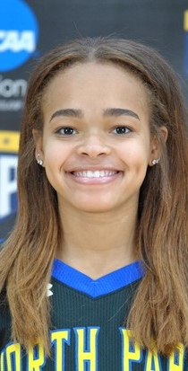
Zakiya newsome
Hometown: Glendale Heights, Illinois
Academic Major: Sociology
Post-Collegiate Plans: I plan to continue working at webster’s Dental Care as a Dental Assistant. While doing that, I will look for a job in my field, preferably something that has to do with helping people, especially kids.

Slide 61
wheaton men’s
basketball

Slide 62
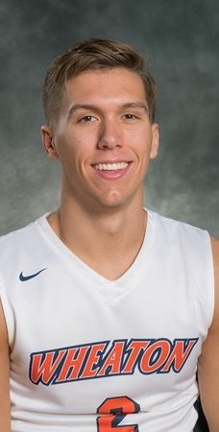
Cade alioth
Hometown: Mechanicsburg, Pennsylvania
Academic Major: Economics

Slide 63
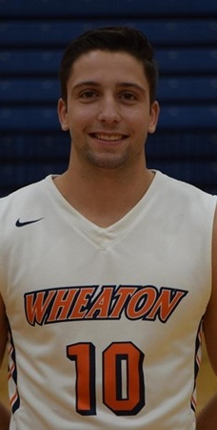
Collin uveges
Hometown: Bartlett, Illinois
Academic Major: Mechanical Engineering

Slide 64
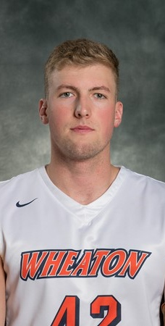
Gavin hawkins
Hometown: Little Rock, Arkansas
Academic Major: Applied Health Sciences
Post-Collegiate Plans: I plan to attend and graduate medical school. After this, I plan to start a family.

Slide 65
Wheaton women’s
basketball

Slide 66
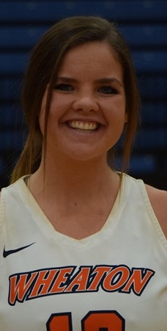
Hannah williams
Hometown: Fishers, Indiana
Academic Major: Business Economics/English Writing
Post-Collegiate Plans: After graduating I plan on moving to Raleigh, North Carolina in July 2022 to work for Cisco Information System in their CSAP program as a Sales Associate.

Slide 67
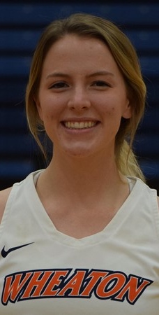
Bonnie zeller
Hometown: Minneapolis, Minnesota
Academic Major: Applied Health Science
Post-Collegiate Plans: After graduation, I will take a gap year to apply to nursing schools for my MSN. The plan is to move back to Minneapolis and gain some experience working in a children's hospital.

